Slide 1

#HourOfCode 2020
Introduction to Deep Learning
And Fast.ai
By
Amandeep Kaur
Muskan Lalit

Slide 2
Agenda
Style
01
AI VS ML VS DL
02
History
03
Working theory of DL
04
Analogy with human brain

Slide 3
Agenda
Style
05
Neural Nets
06
Need for Deep Learning
07
DL Frameworks and Library
08
Applications of DL

Slide 4
Agenda
Style
09
Limitations in DL
10
Resources for you
11
FAST.AI
12
Debate time

Slide 5
AI vs ML vs DL
Whenever a machine completes tasks based on a set of stipulated rules that solve problems (algorithms), such an “intelligent” behavior is what is called artificial intelligence
Artificial Intelligence
Machine Learning
Machine learning is the study of computer algorithms that allow computer programs to automatically improve through experience.
Deep Learning
Deep learning is a subset of machine learning where artificial neural networks, algorithms inspired by the human brain, learn from large amounts of data.

Slide 6
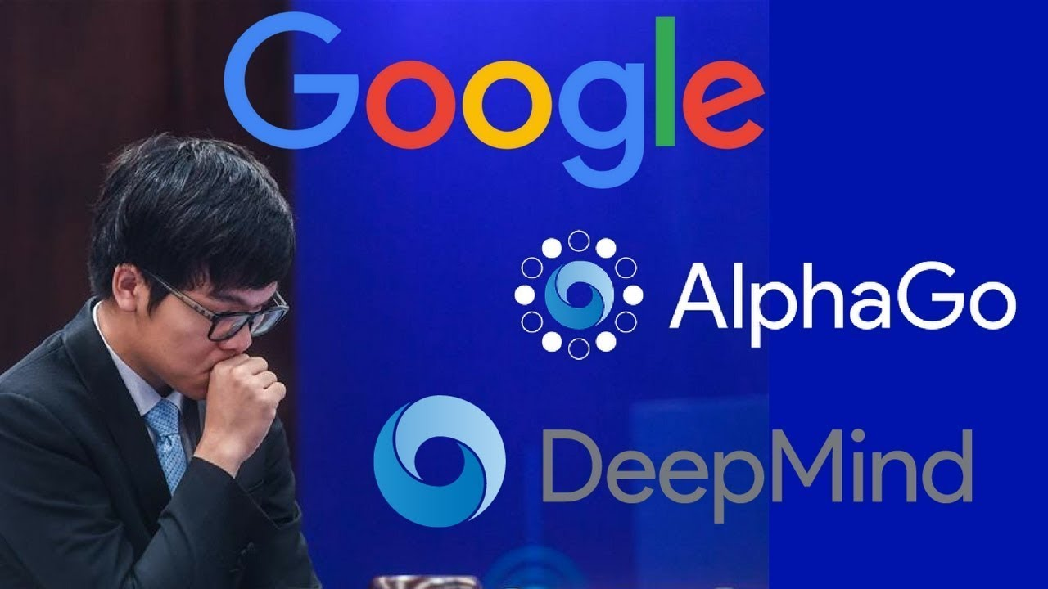
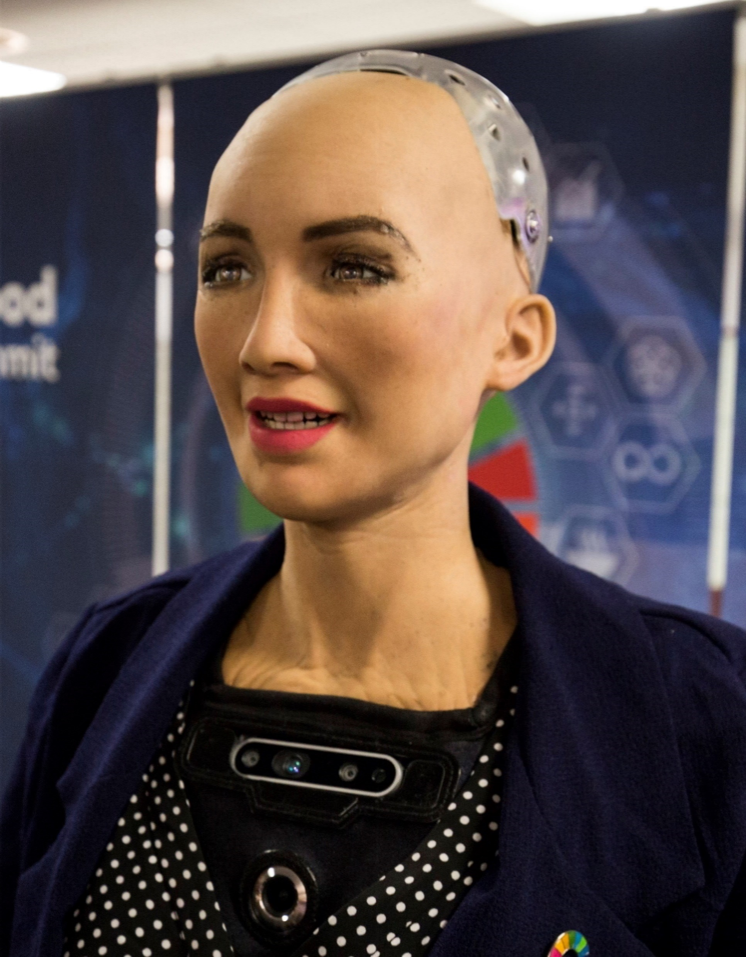



AI
Artificial Narrow Intelligence (ANI)
Artificial General Intelligence (AGI)
Artificial Superintelligence (ASI)
AlphaGo
Read here
Sophia: The Robot
Hiroshi Ishiguro: The Man Who Made a Copy of Himself
Read paper here
Deep Blue
Read paper here

Slide 7
AI vs ML vs DL
Whenever a machine completes tasks based on a set of stipulated rules that solve problems (algorithms), such an “intelligent” behavior is what is called artificial intelligence
Artificial Intelligence
Machine Learning
Machine learning is the study of computer algorithms that allow computer programs to automatically improve through experience.
Deep Learning
Deep learning is a subset of machine learning where artificial neural networks, algorithms inspired by the human brain, learn from large amounts of data.

Slide 8
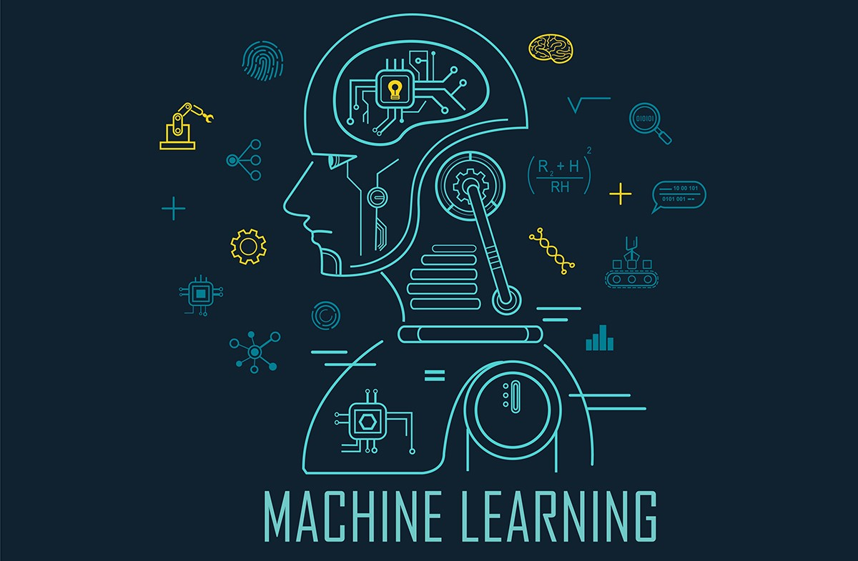
ML
“Machine learning is all about learning from the past, applying in the present and predicting the future”.
No Free Lunch Theorem
Read paper here

Slide 9
AI vs ML vs DL
Whenever a machine completes tasks based on a set of stipulated rules that solve problems (algorithms), such an “intelligent” behavior is what is called artificial intelligence
Artificial Intelligence
Machine Learning
Machine learning is the study of computer algorithms that allow computer programs to automatically improve through experience.
Deep Learning
Deep learning is a subset of machine learning where artificial neural networks, algorithms inspired by the human brain, learn from large amounts of data.

Slide 10
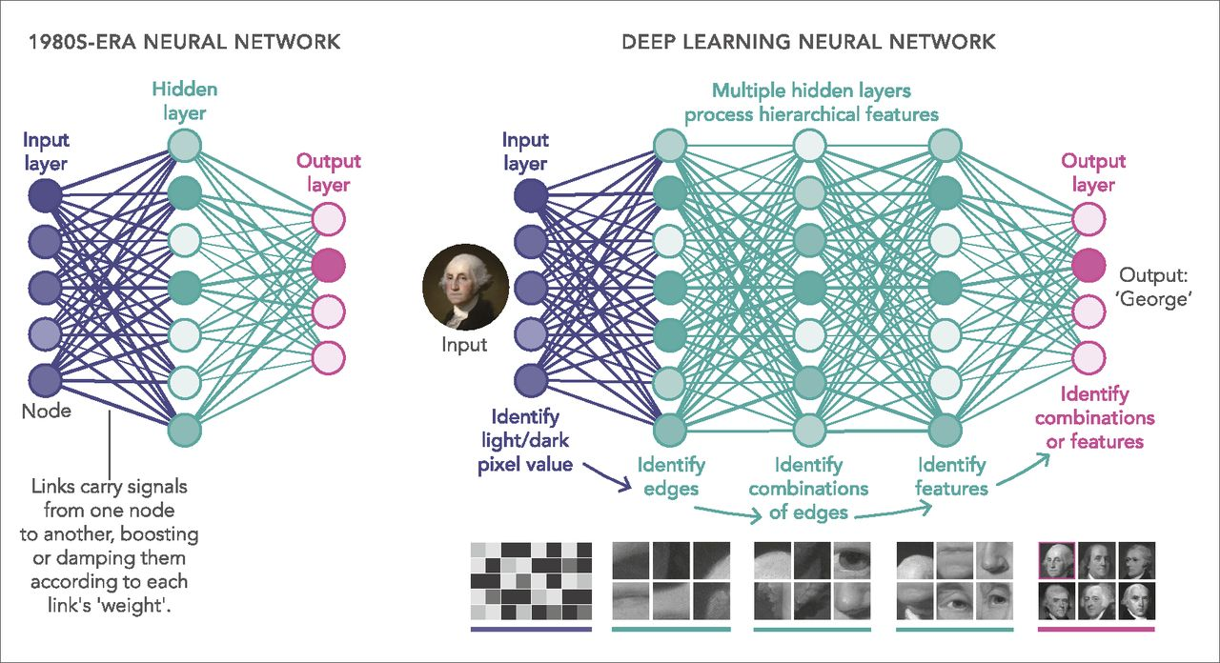
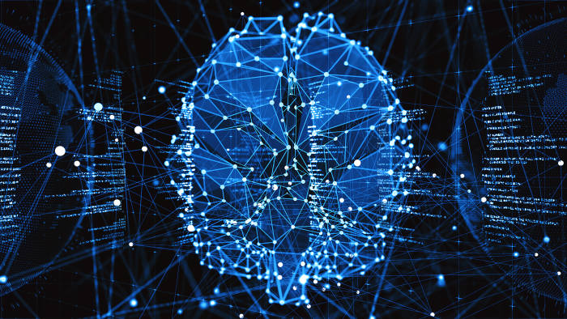
DL
Deep learning is an AI function that mimics the workings of the human brain in processing data for use in detecting objects, recognizing speech, translating languages, and making decisions.

Slide 11
History
Read paper here
Read Here
Warren McCulloch and Walter Pitts created a computational model for neural networks using mathematics and algorithms.
Deep Learning gained popularity following the publication of a paper by Geoffrey Hinton and Ruslan Salakhutdinov that showed how a neural network with many layers could be trained one layer at a time.
Google DeepMind's algorithm, AlphaGo, mastered the complicated board game Go, beating professional player Lee Sedol at a tournament in Seoul..
1943
1958
2006
2012
2014
2020
Read Here
American psychologist, proposed the classical perception model, the mighty artificial neuron.
Google made a huge impression on deep learning when its algorithm revealed the ability to recognize cats..
The 3D models of proteins that AlphaFold generates are far more accurate than any that have come before - marking significant progress on one of the core challenges in biology..

Slide 12
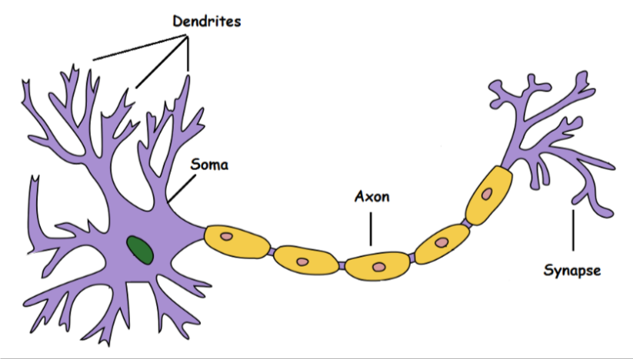
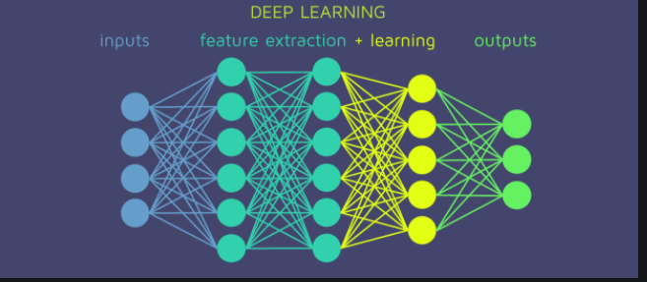
Neural?
A neuron takes an input signal (dendrite), processes it like the CPU (soma), passes the output through a cable like structure to other connected neurons (axon to synapse to other neuron’s dendrite)

Slide 13
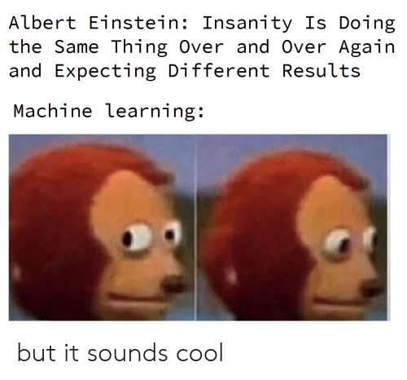
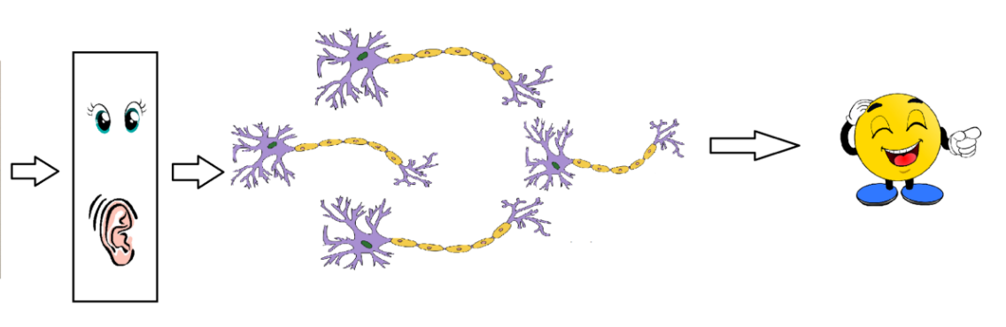
Understanding how neurons work???

Slide 14
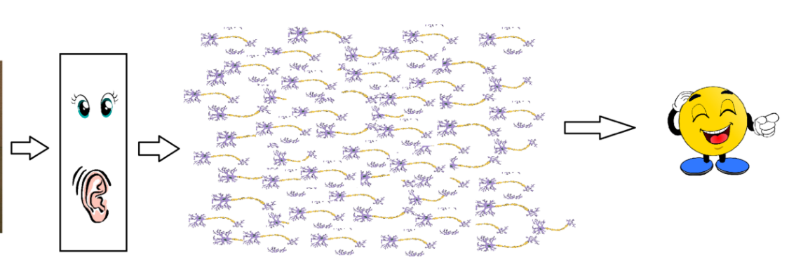
In Reality…….

Slide 15
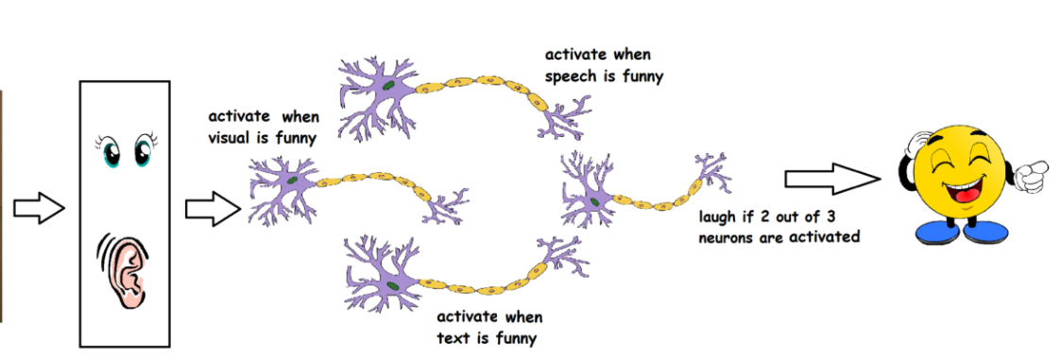
Simply put…
The sense organs pass the information to the first/lowest layer of neurons to process it. And the output of the processes is passed on to the next layers in a hierarchical manner, some of the neurons will fire and some won’t and this process goes on until it results in a final response

Slide 16
Artificial Neural Networks
Collection of connected units called artificial neurons (analogous to axons in a biological brain) Organized in layers of signaling cascades Each neuron transmits a signal to another neuron Neurons may have state
Represented by a number between 0 and 1 Variable parameters Neurons may have a weight that varies as learning proceeds, which can increase or decrease the strength of the signal that it sends downstream Neurons may have a threshold (bias) such that only if the aggregate signal is below (or above) that level is the downstream signal sent

Slide 17
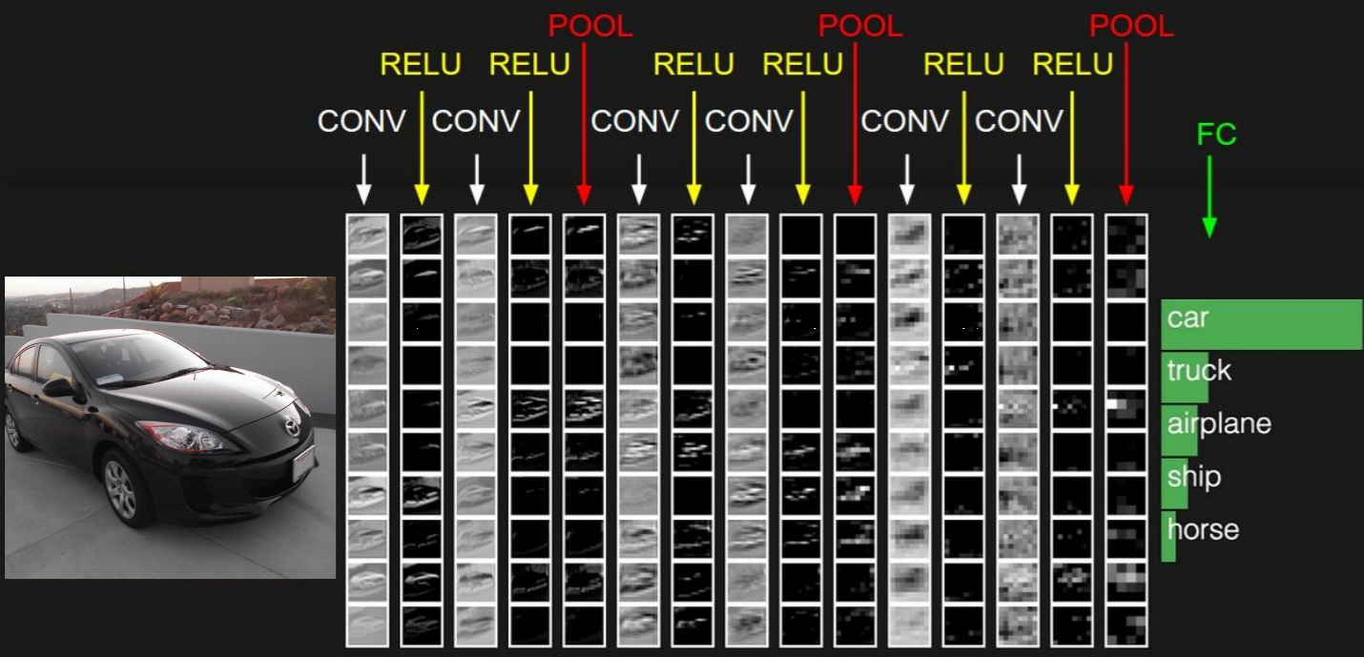
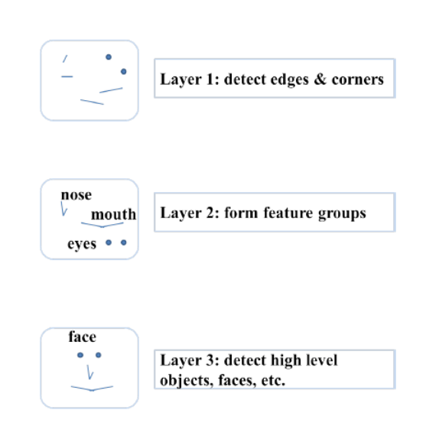
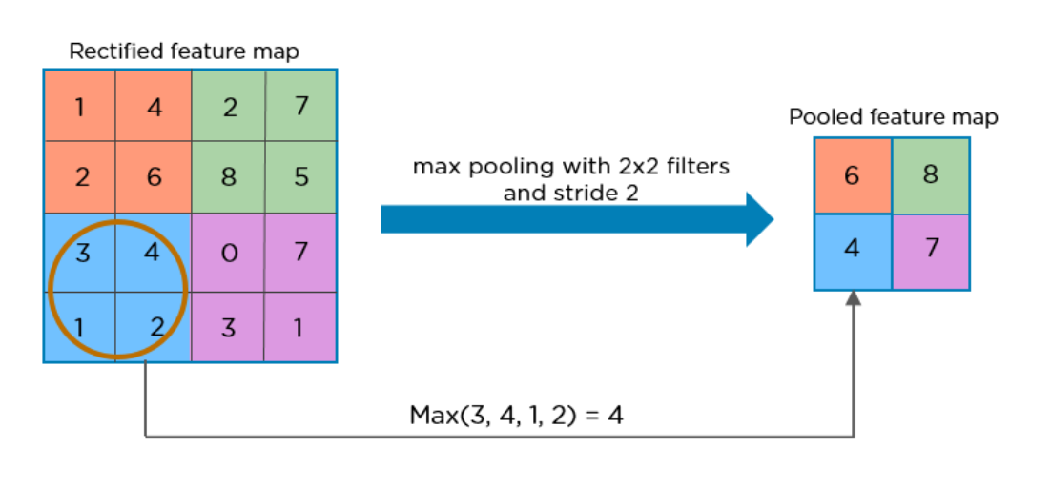
CNN
CNN is a deep neural network originally designed for image analysis
CNN always contains two basic operations, namely convolution and pooling.
The convolution operation using multiple filters is able to extract features (feature map) from the data set, through which their corresponding spatial information can be preserved.
The pooling operation, also called subsampling, is used to reduce the dimensionality of feature maps from the convolution operation.

Slide 18
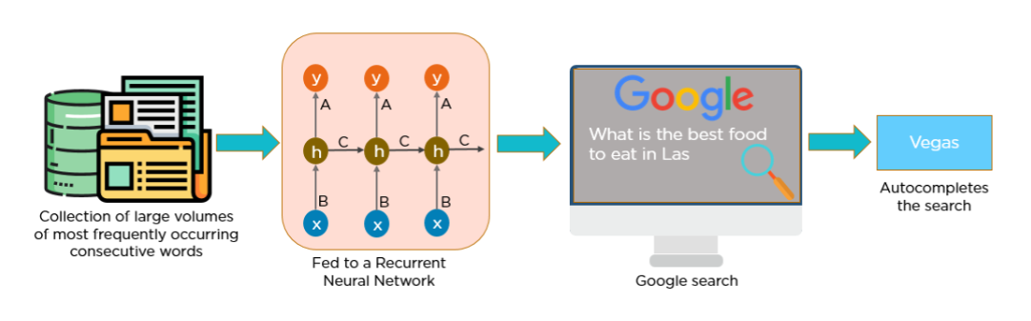
RNN
Recurrent Neural Network(RNN) are a type of Neural Network where the output from previous step are fed as input to the current step.
Refer here

Slide 19
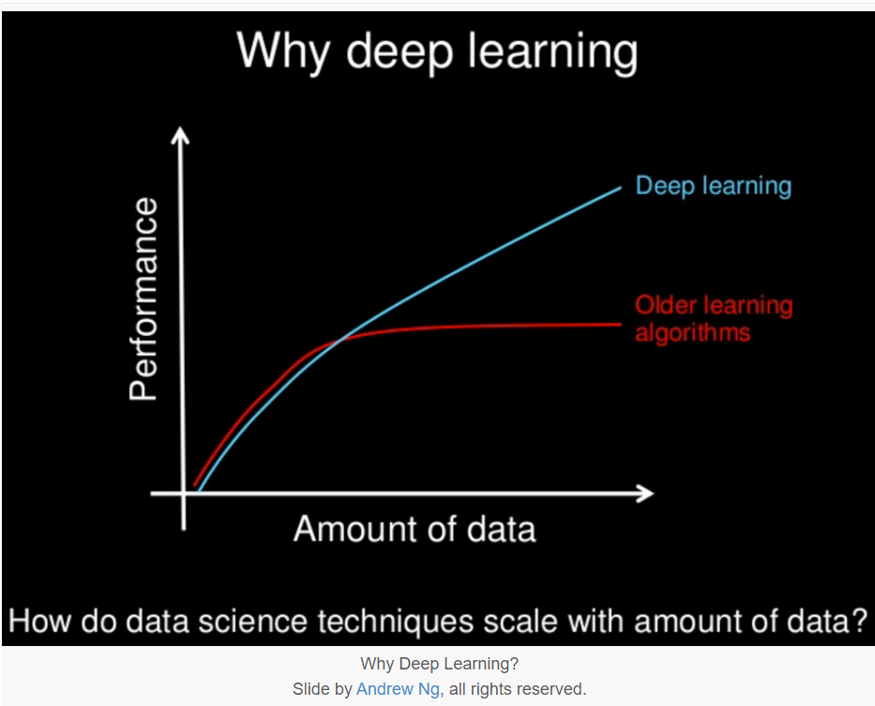
Need of DL

Slide 20
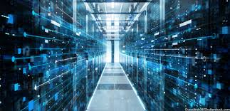
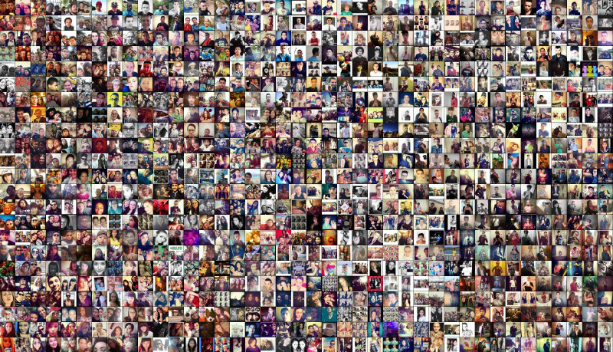
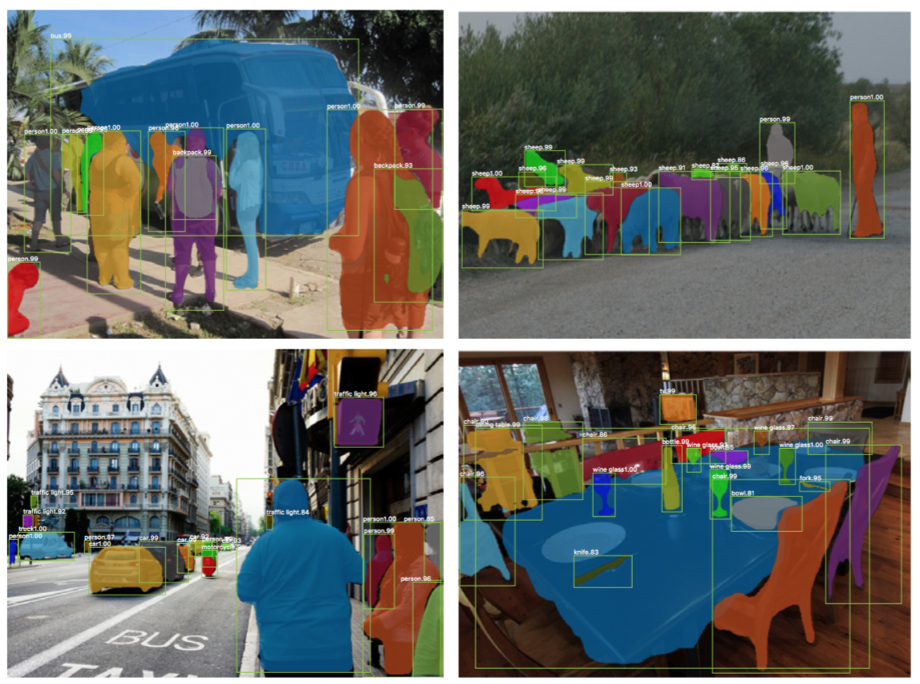
Confusion: ML or DL
Deep Learning out perform other techniques if the data size is large. But with small data size, traditional Machine Learning algorithms are preferable.
Deep Learning techniques need to have high end infrastructure to train in reasonable time.
When there is lack of domain understanding for feature introspection, deep Learning techniques outshines others as you have to worry less about feature engineering.
Deep Learning really shines when it comes to complex problems such as image classification, natural language processing, and speech recognition.

Slide 21

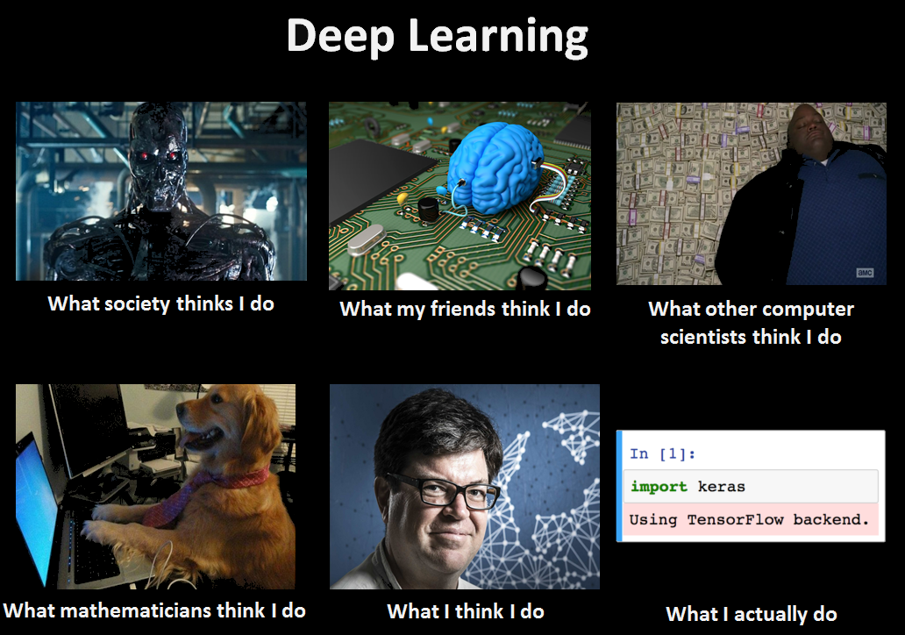

DL frameworks & Libraries

Slide 22

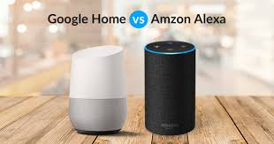
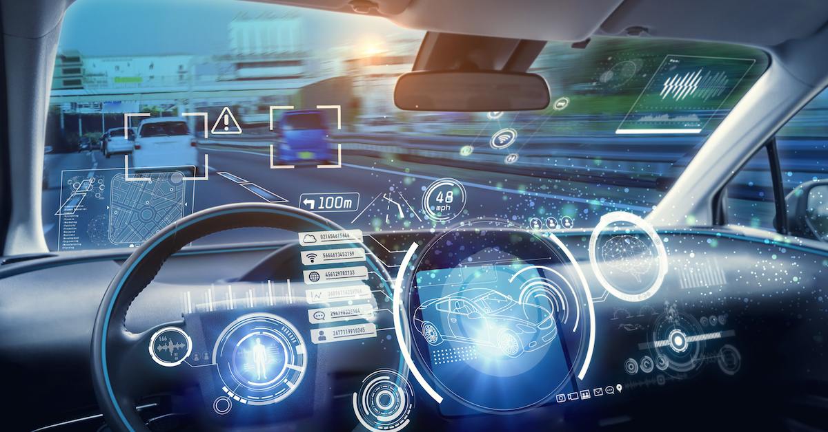
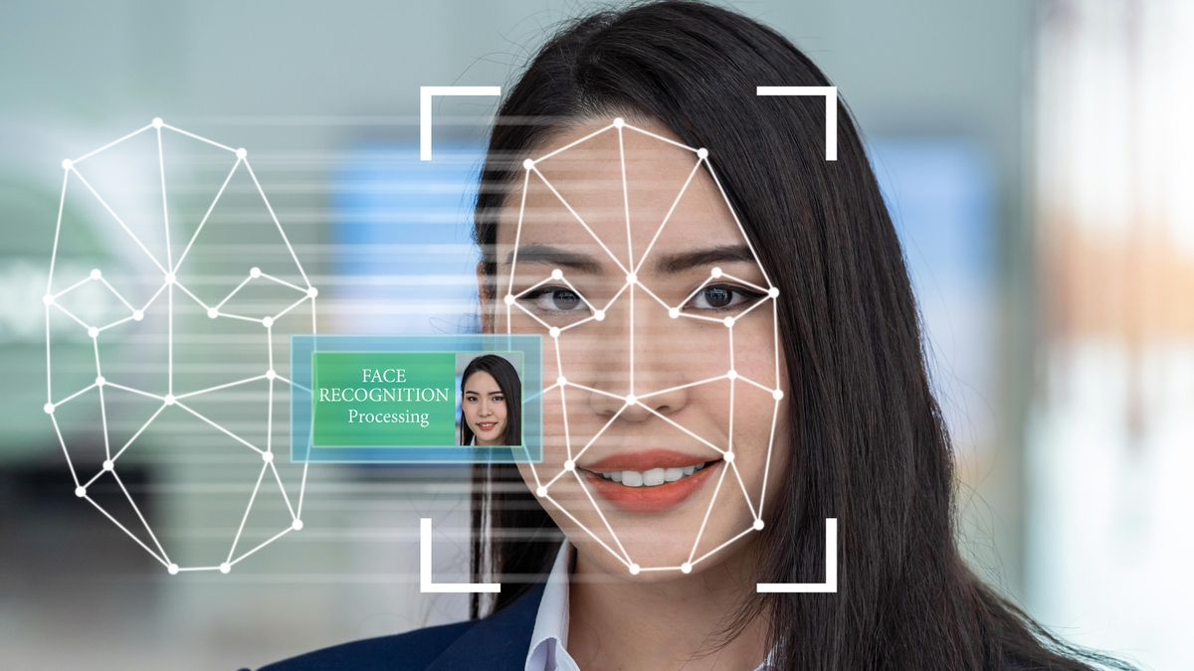



Applications

Slide 23

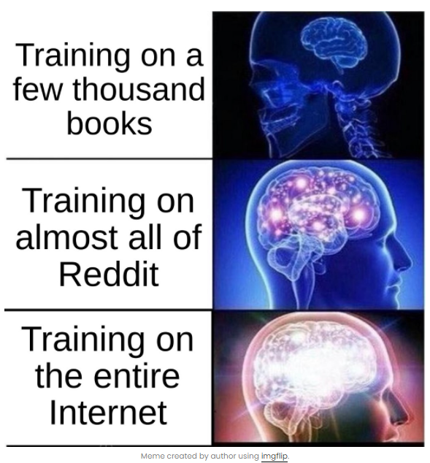
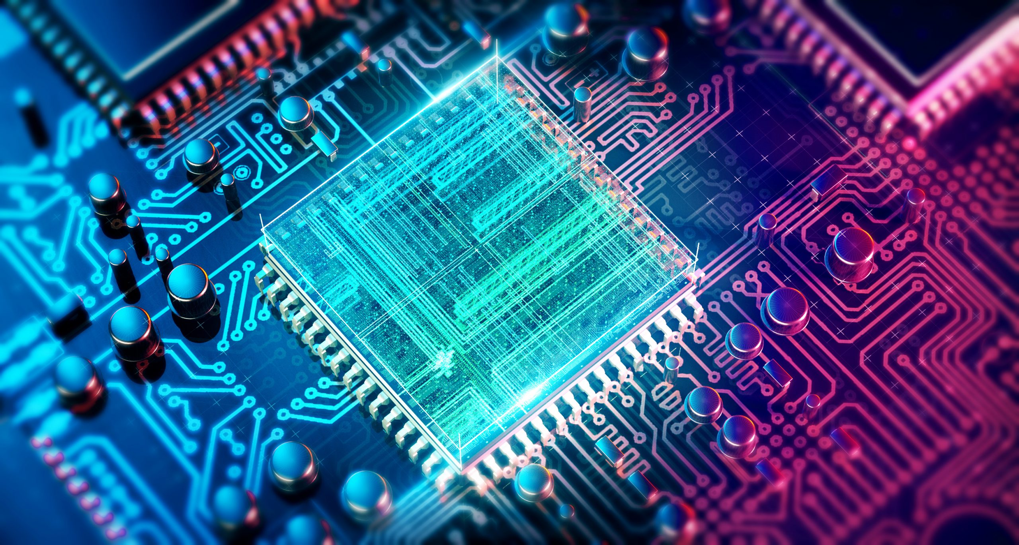
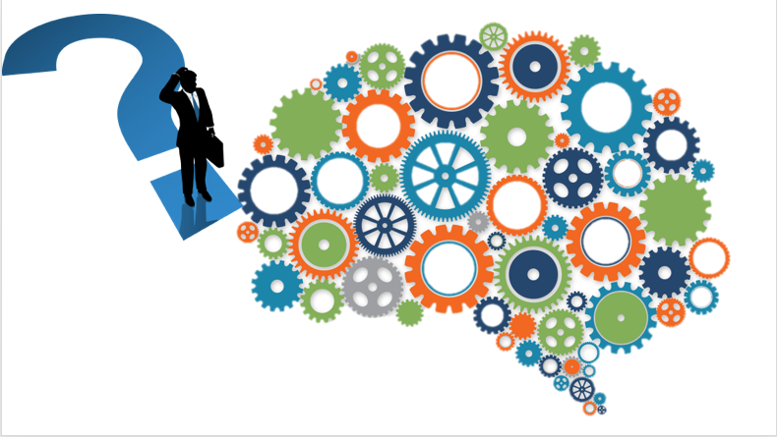
Limitations
Bias
Read solution here
Explainable AI
Hardware
Dataset

Slide 24
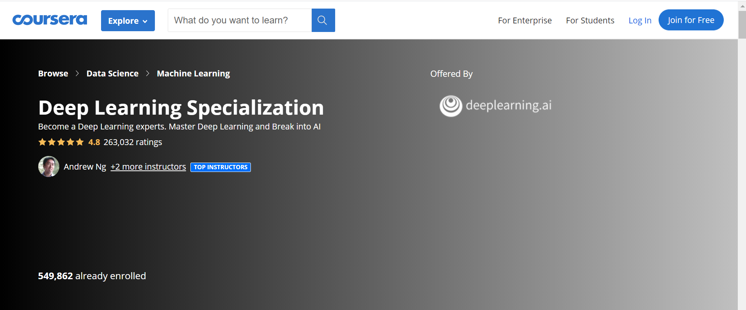
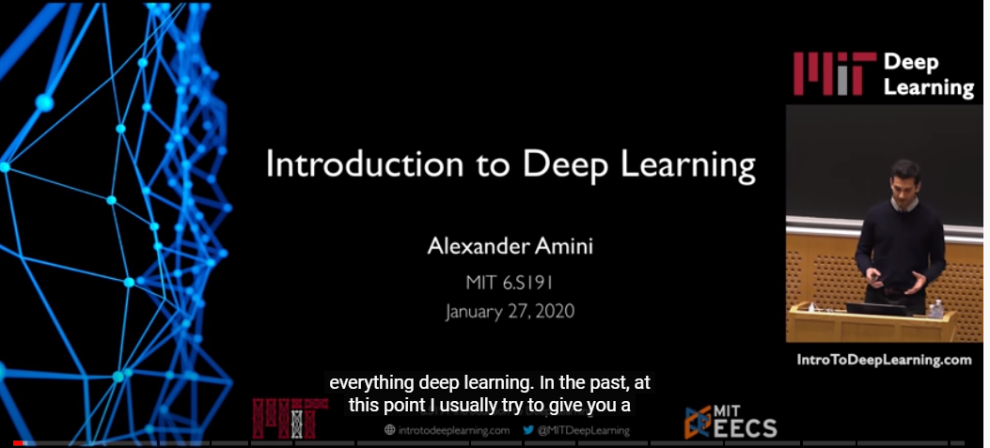

Resources
No need to wander when resources are just here for you!
Blog: MIT Technology Review
Blog: Machine Learning Mastery
Coursera Course on Deep Learning
Blog: Towards AI
Blog: MathWorks
MIT Course on Deep Learning
Blog: Medium
Stanford Course on Computer Vision
.

Slide 25

Connect with me ☺
Github
Portfolio
LinkedIn
Twitter
Gmail

Slide 26
Debate topic
Do AI algorithms reinforce bias in humans or mitigate it?
Do you think AI is like a new life form on earth?

